Slide 1
As a young couple, Zdzisław and Antonina married in the turbulent year of 1938 in Lwów, eastern Poland.
Zdzisław, a fighter pilot in the Polish army, was seized and sentenced by the Soviet Army to imprisonment in the Siberian Labour Camps, the Gulag, in early 1939.
In September of that same year, Lwów was overtaken and absorbed into the Ukrainian Soviet Socialist Republic and Antonina found herself, with many other citizens, deported east into Siberia.
They spent years of enforced labour in the system with no contact or knowledge of each others’ fates.

Slide 2
A treaty in 1942 oversaw the release of a number of Poles from the Gulag system, Antonina and Zdzisław amongst them.
As soldier and nurse, Zdzisław and Antonina, respectively and separately, travelled and worked with the Allied Forces.
One day, via the Red Cross, Zdzisław heard news that his sister had been located in Egypt. Upon travelling to find her, he instead found his wife Antonina.

Slide 3
This visual narrative recounts the couples’ earlier years, their joint story, their long awaited reunion, the time they spent traveling with the Allied Forces thereafter, and their eventual resettlement in Ireland where they found a new home.

Slide 4
Lwów 1926

Slide 5
Lwów 1934

Slide 6
Lwów 1934

Slide 7
Lwów 1936

Slide 8
Lwów 1936

Slide 9
Lwow 1937

Slide 10
Lwów 1937

Slide 11
Lwów 1938

Slide 12
Lwów 1938

Slide 13
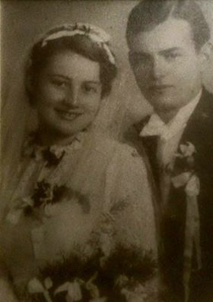
Lwów 1938

Slide 14
Lwów 1938

Slide 15
Lwów 1939

Slide 16
Tehran 1942

Slide 17
Iraq 1942

Slide 18
Eqypt 1943

Slide 19
Port Said 1943

Slide 20
Iraq 1943

Slide 21
Tel Aviv 1942

Slide 22
Tel Aviv 1943

Slide 23
Rome 1945

Slide 24
Rome 1945

Slide 25
Rome 1945

Slide 26
London 1947

Slide 27
Waterford 1951

Slide 28
Bray 1953

Slide 29
Bray 1954

Slide 30
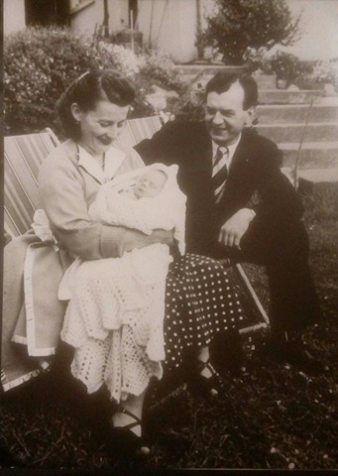
Bray 1954

Slide 31
Brittas Bay 1956

